Slide 1
JSPR-Techies
Building a Platform for Academic Excellence
12/8/2023

Slide 2
JSPR-Techies
Team Members
Jayani Sumanka Gerine jayanis@umich.edu
Pallavi Dabade pallavid@umich.edu
Raksha Varahamurthy rakshav@umich.edu
Surya Subramani suryasss@umich.edu

Slide 3
JSPR-Techies - Introduction
Project Purpose:
The purpose of the project is to develop a comprehensive platform that enhances the user experience for both students and professors within the university community. The platform leverages Artificial Intelligence (AI) algorithms to provide a personalized and efficient article search experience.
Objectives:
User-Friendly Platform
Informative Content
AI assisted Search Recommender
Collaboration and Community Building
24/7 Support and Continuous Improvement

Slide 4
JSPR-Techies - Project Overview
Domain - TechBlog for University of Michigan Students
End User - University of Michigan Students, Faculties, Alumnus
Purpose -
Developing a comprehensive platform that allows end users to search Top 5 articles based on their set of preferences which are derived using AI Algorithms.

Slide 5
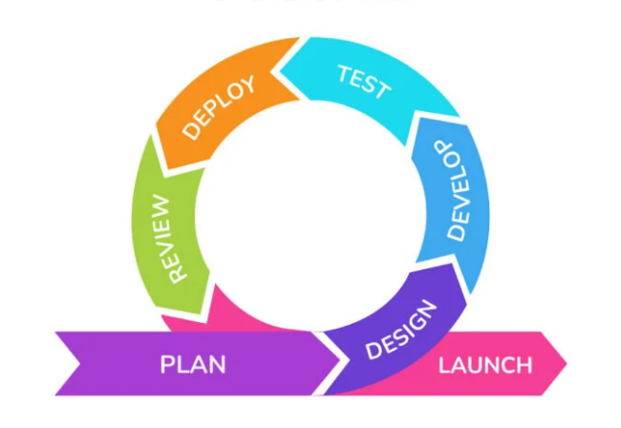
JSPR-Techies - Project Development
Planning
Requirement Engineering
System Specifications
Prototype
Backlog
System Design
Architectural Diagram

Slide 6
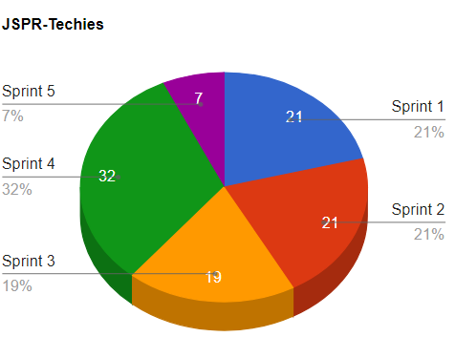
JSPR-Techies - Project Scope
Sprint 1 - System Specifications
Planning
Sprint 2 - Checkpoint 1
System Design
Sprint 3 - Checkpoint 2
Development
Sprint 4 - Checkpoint 3
Development & Testing
Sprint 5 - Release
Demonstration

Slide 7
JSPR-Techies - Project Development
Development
Database Development
UI Development
Testing
Cope Inspection
QA Testing, Stress Testing, UAT
Deploy & Release
Demonstration

Slide 8
JSPR-Techies - Project Scope
Total User Stories - 79 User stories
Sprint 1 - 11/1/23 to 11/10/23 4 User Stories 21 points
Sprint 2 - 10/27/23 to 11/10/23 3 User Stories 21 points
Sprint 3 - 11/10/23 to 11/20/23 6 User Stories 19 points
Sprint 4 - 11/20/23 to 12/5/23 5 User Stories 32 points
Sprint 5 - 12/5/23 to 12/8/23 7 User Stories 7 points

Slide 9
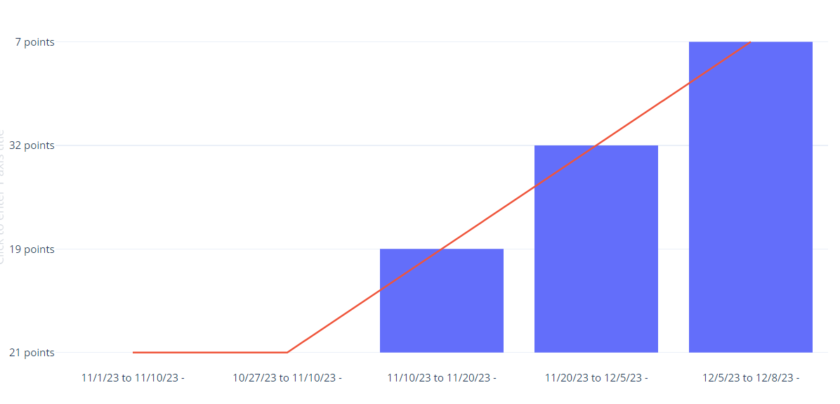
JSPR-Techies - Timeline

Slide 10
JSPR-Techies - Technologies Used
Project Management - Jira Board
Code Management - GitHub
Database - MySQL
Coding Language - Python, HTML, CSS
Prototyping - Figma Board
Collaboration - Google Meet, Whats app
Documentation - Google Doc

Slide 11
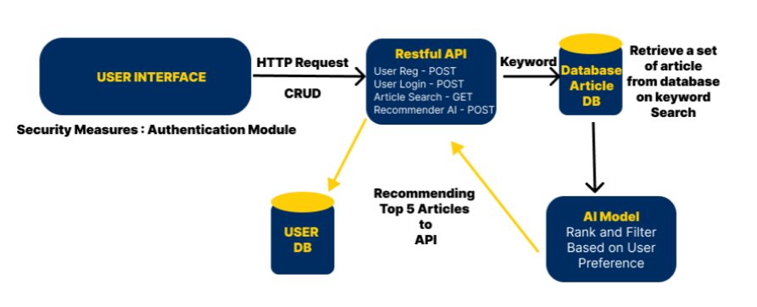
JSPR-Techies - Architecture Overview

Slide 12
JSPR-Techies - Challenges Faced
Database Integration

Slide 13
JSPR-Techies - User Interface (UI)

Slide 14
JSPR-Techies - Features

Slide 15
JSPR-Techies - Database Structure

Slide 16
JSPR-Techies - Testing

Slide 17
JSPR-Techies - Lessons Learned

Slide 18
JSPR-Techies - Future Enhancements

Slide 19
JSPR-Techies - Conclusion

Slide 20
JSPR-Techies - Q&A
Any Feedback?
Thank You!!

